Slide 1
Collaborative Intelligence:
The Future of Email Security with Crowdsourced Intelligence and Machine Learning
Notes:
Juergen - Welcome to this session where we’ll be looking at how to balance the increased financial pressures combined with Skillset Shortages & how to Maintain Email Security, whilst looking at an example of this in action.

Slide 2
THE PHISHING CHALLENGE
Cofense identifies a malicious email that bypassed a “Secure” Email Gateway every
2
minutes
some users will
CLICK
Notes:
Industries such as finance, healthcare, infrastructure and local government are all key targets we know, but the reality is that no organisation is safe from email threats. When looking at the defence of organisations against the ever-evolving email threat landscape, you must accept two fundamental factors:
Despite advances in email security solutions such as artificial intelligence, threats still reach the inbox. Don’t forget that attackers have this technology at their disposal too and are continuously working on ways to get through.
The second is that the best user awareness program in the world will not stop every user clicking on every threat, every time.
Can you say with certainty, that your technical controls are stopping every email threat?
What visibility do you have over threats that are bypassing controls?
How are you raising awareness of evolving email threats amongst your organisation?
Over 90% of cyber security attacks happen via email phishing. That’s a staggering statistic. Business Email Compromise, Credential Phishing and Ransomware continue to dominate headlines around the world, with big brands making the news for security breaches on a growingly regular basis.

Slide 3
PHISHING ATTACKS EVADING EMAIL SECURITY
60%
2%
Malicious Links
Malicious Attachments
SOURCE: Cofense
Notes:
Threat actors are continually innovating to deliver malicious emails to your inbox. You may see your people as being a weakest link and rely on security technology, but don’t forget that attackers have this technology at their disposal too and are always innovating ways to get through.
We have seen a significant shift over the last couple of years away from malicious attachments towards malicious links. It’s no surprise given these figures; when it’s no longer effective they change tactics. Emails containing malicious links – or no links at all – are much more likely to make it to the inbox undetected by email security controls.

Slide 4
THE PHISHING THREAT LANDSCAPE TODAY
SOURCE: 2023 Annual Phishing Report, Cofense
Notes:
Our Cofense Intelligence monitors and reports on the latest phishing threats, and 100% of the phish Cofense analyses are reported by end users, none of them of which were stopped by their secure email gateways (SEGs).
Our latest report showed some staggering results.
Over the last couple of years, Cofense has observed a significant shift in tactics as threat actors have moved away from attachment-based malware towards credential phishing. Business email compromise emails contain no payload; threat actors employ social engineering and exec spoofing to trick recipients into transferring funds or revealing sensitive information. Only 3% of the malicious emails reported to us by our customers was delivered malware.
80% of emails analyzed contained a malicious link, but as the life can be very short, sometimes measured in just a few hours, it may no longer even be active by the time the email is reported to us. This shows the importance in being able to act fast with the threats that get through.

Slide 5
THREATS MISSED BY GATEWAYS IN 2022
SOURCE: 2023 Annual Phishing Report, Cofense

Slide 6
Email phishing is a human problem that requires human-centric solutions
Notes:
I’ll leave you with one last thought, the phishing attack surface is both technical and human. Since no technology or automation is ever likely to be 100% effective against phishing, we need to turn humans targets into defenders to act as the last line of defence – deploying an adaptive and layered defence.

Slide 7
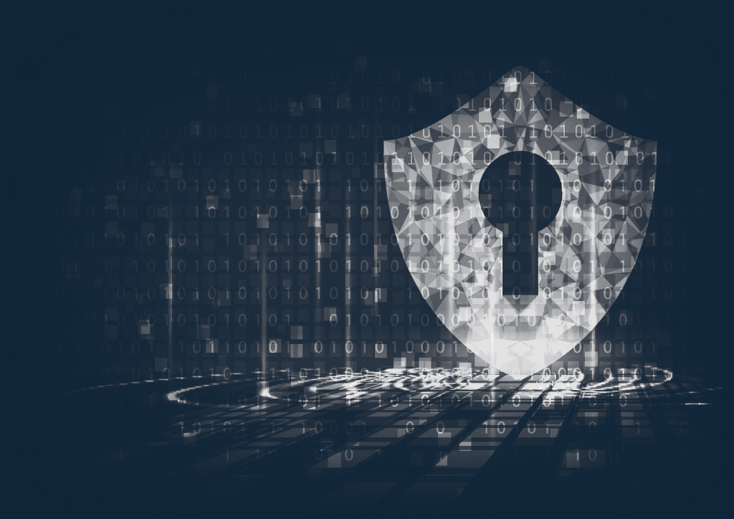
PRIORITIES FOR EFFECTIVE PHISHING DEFENCE
1
Get visibility of the threats the technology missed
2
Respond and neutralise threats faster

Slide 8
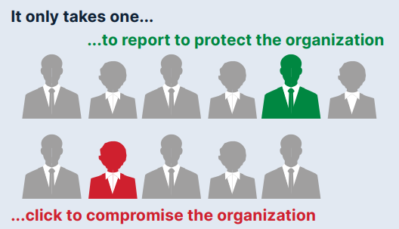
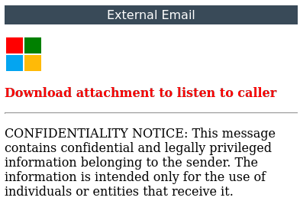
GAIN VISIBILITY
Notes:
Your employees are a valuable last line of defense and can contribute to you gaining visibility of the threats technology missed. It only takes one, and this is the importance of training regularly, but most importantly on live and current threats, and then enabling them with the tools to effectively report those identified.

Slide 9
ONE OF THESE IS BAD
Notes:
Threat actors use increasingly sophisticated tactics to trick users into interacting with their emails. The malicious email is virtually indistinguishable from the legitimate one. Educating users what legitimate Microsoft emails look like and being cautious about unknown senders and domains is essential.

Slide 10
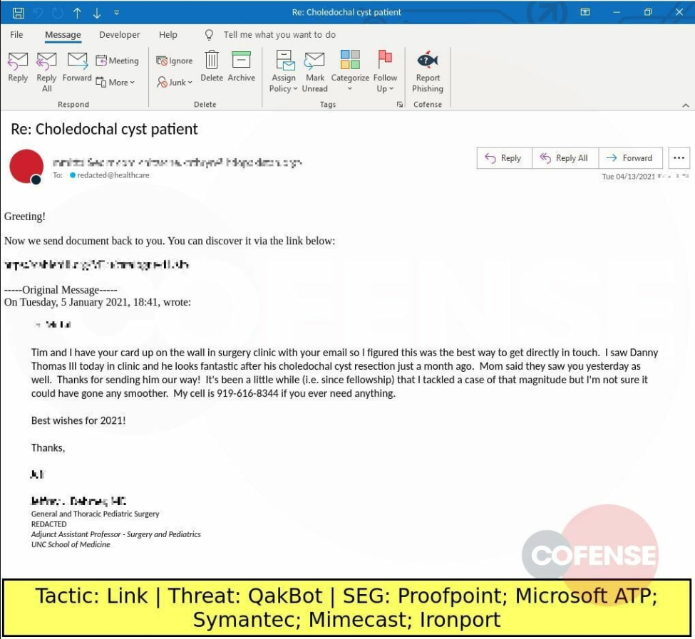
Thread Hijacking
Already responded, already trusted
Very difficult for end-users to detect
Compromised account somewhere
Through a successful phish!
Users aware of email thread
Insert attack at last minute
Frequently use email forward rules
Continue to work after password reset
Notes:
Threat actors use increasingly sophisticated tactics to trick users into interacting with their emails. The malicious email is virtually indistinguishable from the legitimate one. Educating users what legitimate Microsoft emails look like and being cautious about unknown senders and domains is essential.

Slide 11
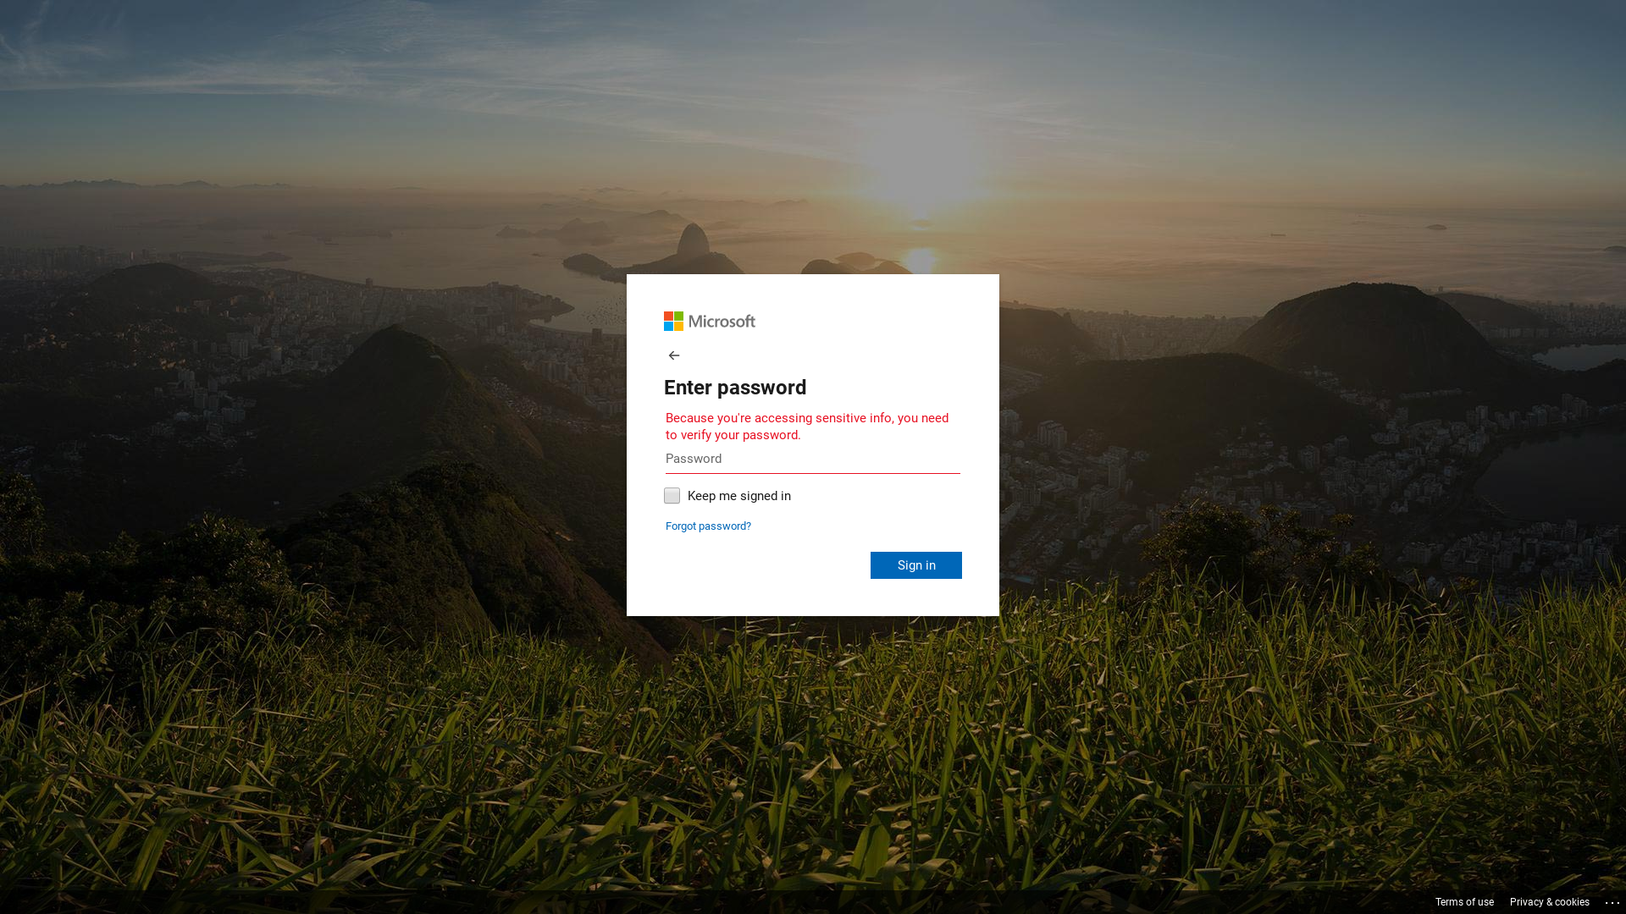
https://microsoftpassupdate-0989microsoftpass0-9488updateexpiringupdat.s3.us-east.cloud-object-storage.appdomain.cloud/index.html
Notes:
All of these tactics attempt to trick the recipient to give up their credentials, often through a convincing login page.
While Multi-factor authentication is a great defense against phishing, it’s not infallible. Constant vigilance is still essential.

Slide 12
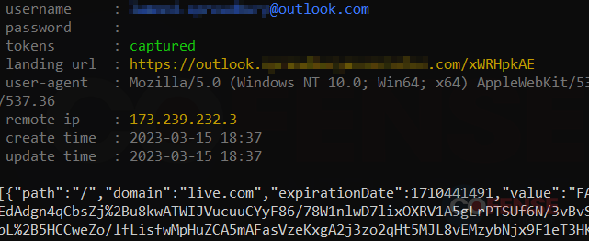
Bypassing MFA with Credential Phishing
During the login, the fake page will pass on any received username and password to the destination website.
It will also present the MFA request to the user for further input, and forward any responses to the destination
The attacker can decrypt and extract the session cookie before sending it along to the user
In credential phishing, a man-in-the-middle server will act as a proxy between the user and the actual destination
Notes:
Recent Cofense Intelligence Strategic Analysis discovered how Threat Actors are using Man-in-the-middle servers to get access to session cookies, even when MFA is in use. Once the attacker has the session cookie, he can use it to interact with the website as if he were the user. This session cookie allows him to bypass usernames, passwords, and even the multi-factor authentication steps. Using that session cookie, he will be granted all the access and permissions associated with that account.

Slide 13
The Power of Intelligence…
HUMAN INTELLIGENCE
EMAIL ATTACK INTELLIGENCE
ARTIFICIAL INTELLIGENCE
A unique combination of sources of intelligence
Notes:
Threat actors use increasingly sophisticated tactics to trick users into interacting with their emails. The malicious email is virtually indistinguishable from the legitimate one. Educating users what legitimate Microsoft emails look like and being cautious about unknown senders and domains is essential.

Slide 14
TRAINING…
IS NOT ENOUGH
It’s important to educate end users but doing so will not stop real phishing attacks landing in their mailboxes
Keep your emotions in check
Look for warning signs
Examine the domain name
Always verify the sender
Keep credentials private
Report suspicious emails
Notes:
Creating this valuable internal threat detection will help you to identify the threats missed, but its worth noting… this isn’t enough as it won’t stop the real threats getting into inboxes.

Slide 15
RESILIENCE TAKES MORE THAN REPORTING
In a well-educated organisation,
20
% of employees report an email each month
But
92
% of them are not malicious
Notes:
In a well educated organisation, about 20% of employees report an email each month. Think about your own organisation; does your security operations team have sufficient resources to handle that number of emails? ​
Reviewing suspicious emails directly in the abuse mailbox is laborious, time consuming and never-ending. Analysts hate doing it, particularly when most of the time those reported emails are not a threat​
​

Slide 16
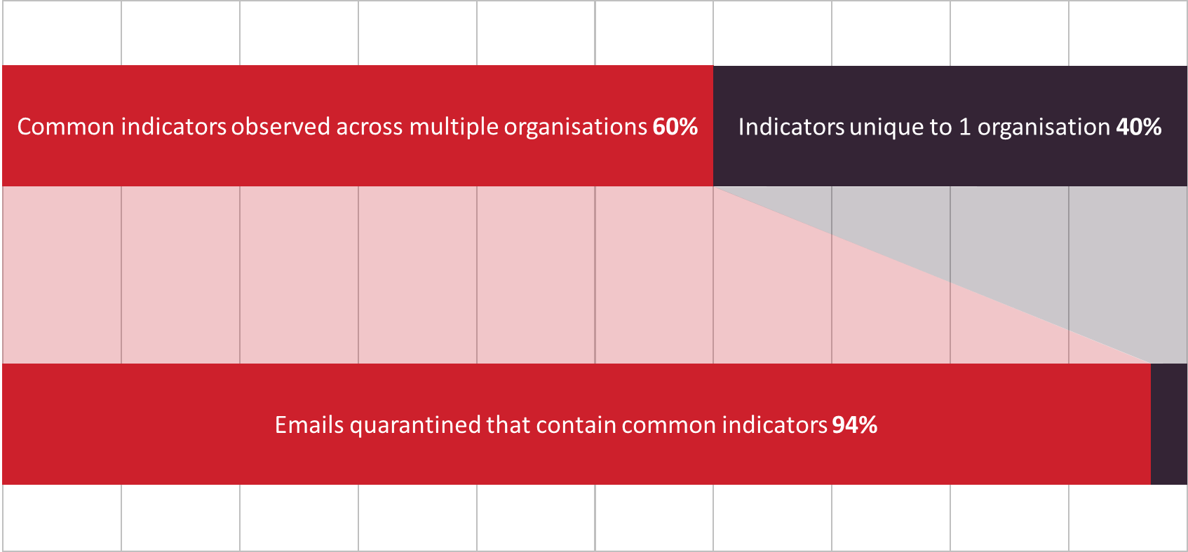
THE NETWORK EFFECT
Notes:
This is where the importance of leveraging crowdsourced intelligence comes in. By utilising crowdsourced intelligence you can access data you could only dream of obtaining from your own network, helping to not only understand the latest threats being seen in the wider market, but also increase the speed at which threats can be identified and remediated, and even automating this saving valuable resources and time! Cofense has built a global network of over 35 million threat reporters, and because of this there’s a significant chance we have already seen a threat before you report it. This means we can react instantly and auto-quarantine threats from every inbox in our network before employees can interact with them. The power of leveraging this crowdsourced intelligence allows our customers to remediate 4 times more email threats than those who manage it themselves.​

Slide 17
THE NETWORK EFFECT – CASE STUDY
Healthcare Industry: 23,000 employees, 1 month
Proactively quarantined by Cofense over the same period
Emails Quarantined
491
4,544
Reported by Users 201
Notes:
By combining this crowdsourced intelligence with machine learning you take your email security to the next step. Creating intelligent layers of defense that protect, detect and respond to email threats faster. Just look at this example of just what a difference utilizing these combinations of intelligence can have.​
​

Slide 18
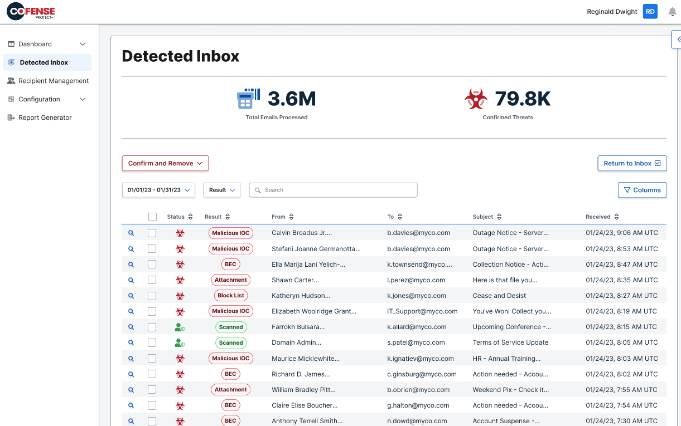
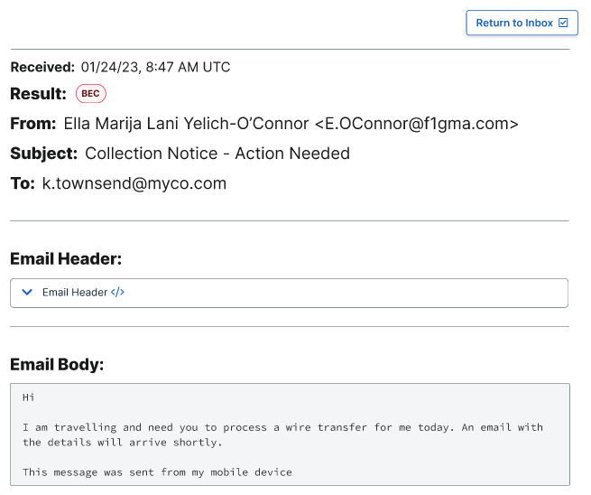
Protect + Detected Inbox
Enterprise-Grade protection level based on Cofense Intelligence IOC Matching
This tab shows the emails that were detected by Protect+, as they matched a previously known, human-vetted, IOC Identifier (Bad URL\Attachment\Sender etc.) fed from the Cofense Intelligence network
A Protect+ Operator is able to move emails back to Inbox (Return to Inbox) or move them to Deleted Folder (Confirm and Remove)

Slide 19
AN INNOVATOR IN EMAIL SECURITY
PhishMe: the 1st phishing simulation platform
Reporter: the 1st report phishing button
Triage: the 1st dedicated workbench for analysing suspicious emails
Cofense solutions supplement your email gateway to stop the threats they miss

Slide 20
SUMMARY
Email THREATS EVOLVE fast
Security teams UNDER PRESSURE
Need for REAL TIME TRANSPARENCY of threats
Accessing INTELLIGENCE is vital to stay ahead
Employees provide invaluable LAYER OF DEFENSE
35M+ GLOBAL reporters
50K+ emerging attacks identifid monthly, 88% of attacks stopped never seen before
Full end-to-end intelligent email security solution
And most importantly…

Slide 21
CROWDSOURCED INTELLIGENCE + MACHINE LEARNING ​
= ​
faster remediation & improved security posture​
Notes:
Juergen

Slide 22
Questions…
Notes:
Heather to pose questions, Juergen to direct or answer

Slide 23
Thank You!
Notes:
Heather to close

