Slide 1
NOWHERE TO HIDE
ANDRES ESCOBAR
SALES ENGINEER

Slide 2
Today’s Agenda
Falcon OverWatch Overview
Looking Back: Global Intrusion Trends
Regional Focus: EMEA
Looking Deeper: Intrusion Case Studies
Looking Ahead
Q&A

Slide 3
Today’s Agenda
Falcon OverWatch Overview
Regional Focus: EMEA
Looking Deeper: Intrusion Case Studies
Looking Ahead
Q&A

Slide 4
Falcon OverWatch Overview

Slide 5
At the Heart of Every Attack is a Human Adversary With Distinct Motivations, Targets, And Tradecraft
2022 CrowdStrike, Inc. All rights reserved.

Slide 6
Falcon OverWatch Proactive Threat Hunting
1
24/7 human threat hunting, Falcon Platform-wide
2
Patented and proprietary methodologies and tooling
3
Telemetry and analytics at unmatched scale
Attacks Evolve. So Do We.
4
Poised to act at a moment’s notice

Slide 7
OverWatch SEARCH Threat Hunting Methodology
S
E
A
R
C
H
SENSE
10 trillion+ events/week
Millions of endpoints
100s of event types
ENRICH
Threat Graph
Intel on 160+ adversaries
Sophisticated proprietary tools
ANALYZE
20+ years diverse experience
Relentless 24x7x365
Processes hone over years
Thought leadership
RECONSTRUCT
Experience
Threat Graph
Patented Workflows and Tooling
COMMUNICATE
Near real time
Clear insights, zero friction
Community development
HONE
100s of new lessons/week
30% new techniques/year
Always ready for tomorrow
Notes:
OverWatch SEARCH Threat Hunting Methodology
All too often, threat hunting is treated as a discipline that is viewed as a nice to have, or approached in a peace meal fashion – often without structure or a clearly defined purpose
Success in threat hunting is outcomes driven, and as such hunting activities should be deliberate, intentional and follow a clearly defined scope that captures the basis for the hunt, that is, what led to the activity, the data that informed the hunt, methodology and structure of the hunting operation, and a means to capture and apply lessons learned
Talking of structured workflows - Within OverWatch, we have developed SEARCH
A proprietary methodology that captures the structured, iterative and continuous nature of our hunting workflows
This methodology contributes to our ability to hunt at a truly global scale
Our patented technology for hunting provides us with higher fidelity hunting indicators, enabling the discovery and notification of sophisticated threats in real time, benefiting all customers, all the time, regardless of size, location or vertical
Outputs from our continuous hunting operations informing intelligence and IR response and operations, driving R&D initiatives, and continuously feeding back into the Falcon platform as new and improved detections
========
SEARCH Methodology Purpose: To describe the OverWatch hunting methodology and highlight how OverWatch is unique from our competitors hunting services.
SENSE – Before you can hunt, you must have sufficient data to hunt across. The lightweight Falcon sensor delivers a rich, continuous stream of telemetry, which is collected, parsed and enriched within our Threat Graph technology. The Falcon platform provides the capabilities for deep and comprehensive visibility into behaviors across a given organization.
ENABLE – Hunters need to take advantage of our telemetry. Threat Graph provides hunters with deep visibility delivered in real time by ingesting, indexing and enriching over 500 billion events per day. Crowdstrikes Threat Intelligence empowers hunters with detailed, always-current knowledge of tradecraft from more than 130 adversary groups. This intimate knowledge of attacker TTP’s ensures that the team knows what to look for. Overwatch is also empowered by our proprietary tooling, visualization capabilities and team of skilled hunters.
ANALYZE – Overwatch hunters investigate hunting leads and perform hypothesis testing, employing a “think like an attacker” approach. OverWatch threat hunters represent every corner of the industry and have experience analyzing interactive threat activity multiple times per day, ensuring sharp and effective skills in the identification of adversaries.
RECONSTRUCT – Once a signal is extracted from the noise, additional context is required. Overwatch threat hunters are able to understand and document the scope of an intrusion, producing actionable information and recommendations.
COMMUNICATE – OverWatch operates as a native component of the Falcon platform, and a force-multiplier for your team, delivering timely threat information within the single cloud-native console - no additional infrastructure or processes are required.
HONE – Continuous improvement and sharpening of tools is required to combat evolving adversary TTP’s. With each new threat, OverWatch leverages any new insights to drive continuous improvement in detections and future R+D projects. This ensures that Crowdstrike is always evolving and is able to remain effective at stopping breaches.

Slide 8
Looking Back Global intrusion Trends
Key Intrusion Trends & Themes From The Last 12 Months

Slide 9
Key Findings: Threat Hunting By The Numbers
77,000
7 Minutes
1+ Million
Potential intrusions uncovered
Average interval potential intrusions were uncovered
Malicious events prevented
50%
71%
1 Hour 24 Minutes
Increase in interactive intrusions year over year
Of detections were malware-free
Average eCrime breakout time
Notes:
Focus 1: 77,000/7 Minutes
Focus 2: 71%/1Hr 24 Mins
In the 12 months from July 1st 2021 to June 30 2022, OverWatch threat hunters identified 77,000 potential intrusions, which equates to 1 potential intrusion every 7 minutes
That is 77,000 intentional attempts to subvert automated and technology based controls
Interactive intrusion activity uncovered by OverWatch threat hunters was attributed to 36 distinct named threat actors for the period, spanning 7 groups
BEAR, CHOLLIMA, JACKAL, KITTEN, PANDA, SPIDER and WOLF

Slide 10
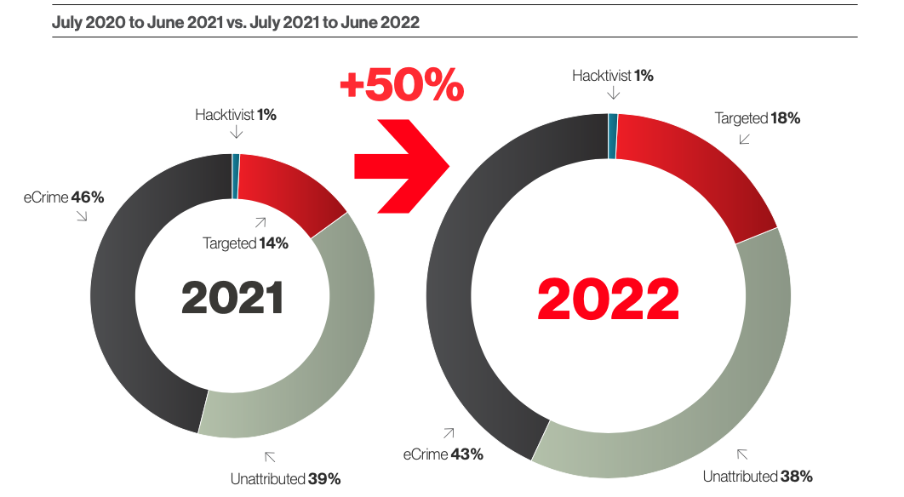
Interactive Intrusion Campaigns By Threat Type
Notes:
Unattributed, but not underestimated

Slide 11
Adversary Tactics & Techniques

Slide 12
Adversary Tactics & Techniques (1/3)
Initial Access
Technique | Sub-technique
Valid Accounts | Domain Accounts
 | Local Accounts
 | Default Accounts
Exploit Public-Facing Application
External Remote Services
Execution
Technique | Sub-technique
Command and Scripting Interpreter | Windows Command Shell
 | PowerShell
 | Unix Shell
 | Python
 | Visual Basic
 | JavaScript
Windows Management Instrumentation
Persistence
Technique | Sub-technique
Valid Accounts | Domain Accounts
 | Local Accounts
 | Default Accounts
Server Software Component | Web Shell
 | IIS Components
Create Account | Local Account
 | Domain Account
Privilege Escalation
Technique | Sub-technique
Valid Accounts | Domain Accounts
 | Local Accounts
 | Default Accounts
Process Injection | Process Hollowing
 | Dynamic-link Library Injection
Scheduled Task/Job | Scheduled Task
 | Cron
Notes:
Talk to the dark of the colours and the valid account aspect
A picture says a thousand words, and a look at the headlamp tells an interesting albeit not overly surprising story
FOCUS ON VALID ACCOUNTS given the focus of identity in todays intrusions
The darker the red the higher the technique prevalence, and with identities under siege and roughly 60% of intrusions today involving the use of compromised accounts, its no surprise to see valid accounts jumping off of the page
Command and Scripting interpreter - when Adversaries abuse command and script interpreters to execute commands, scripts, or binaries, through the use of legitimate credentials granting them access to an account.

Slide 13
Adversary Tactics & Techniques (2/3)
Defense Evasion
Technique | Sub-technique
Valid Accounts | Domain Accounts
 | Local Accounts
 | Default Accounts
Indicator Removal on Host | File Deletion
 | Timestomp
 | Clear Windows Event Logs
 | Clear Linux or Mac System Logs
 | Clear Command History
 | Network Share Connection Removal
Credential Access
Technique | Sub-technique
OS Credential Dumping | LSASS Memory
 | Security Account Manager
 | /etc/passwd and /etc/shadow
 | NTDS
 | LSA Secrets
 | DCSync
Unsecured Credentials | Bash History
 | Credentials In Files
 | Private Keys
 | Credentials in Registry
 | Group Policy Preferences
Discovery
Technique | Sub-technique
System Owner/User Discovery
System Network Configuration Discovery | Internet Connection Discovery
Process Discovery
System Information Discovery
Account Discovery | Domain Account
 | Local Account
Lateral Movement
Technique | Sub-technique
Remote Services | Remote Desktop Protocol
 | SMB/Windows Admin Shares
 | SSH
 | Windows Remote Management
 | VNC
 | Distributed Component Object Model
Lateral Tool Transfer
Notes:
Talk about defense evasion and lateral movement
Interesting observations
Relentless diligence with respects to seeking out more and more credentials, any way they can
Dumping credentials, and pursuing attempts to enumerate many of the plaintext credential stores across Windows and Linux
This extends to cloud

Slide 14
Adversary Tactics & Techniques (3/3)
Collection
Technique | Sub-technique
Archive Collected Data | Archive via Utility
 | Archive via Library
Data from Local System
Data Staged | Local Data Staging
 | Remote Data Staging
Command and Control
Technique | Sub-technique
Ingress Tool Transfer
Application Layer Protocol | Web Protocols
 | File Transfer Protocols
 | DNS
Remote Access Software
Exfiltration
Technique | Sub-technique
Exfiltration Over C2 Channel
Exfiltration Over Alternative Protocol | Exfiltration Over Unencrypted Non-C2 Protocol
 | Exfiltration Over Asymmetric Encrypted Non-C2 Protocol
 | Exfiltration Over Symmetric Encrypted Non-C2 Protocol
Exfiltration Over Web Service | Exfiltration to Cloud Storage
Impact
Technique
Data Encrypted for Impact
Inhibit System Recovery
Resource Hijacking
Service Stop
System Shutdown/Reboot
Notes:
Talk to surging proliferation of remote access software for persistence
Surge in targeting of remote services and remote access software

Slide 15
Adversary Tooling Deep Dive
Emerging, Trending & Mainstay Tools

Slide 16
The Adversary Arsenal
Emerging Tools
fscan
IceApple
Trending Tools
Sweet Potato
ngrok
fatedier
Other reverse proxies
Mainstay Tools
VNC
AnyDesk
AteraAgent
TeamViewer
Cobalt Strike
GMER
Notes:
Emerging: fscan (used for), IceApple (used for)
Trending: Sweet Potato - variation of hot potato privilege esc tool first seen back in 2016, ngrok, fatedier and other reverse proxy tooling
Mainstay: remote access tools: VNC, AnyDesk, AteraAgent, TeamViewer and more (why), cobalt strike, GMER
GMER use in attempts to defeat security tools
Use IceApple as a tie in to AJ’s talk which you can catch tomorrow

Slide 17
Industry Sectors In The Cross Hairs
A Global Perspecitive

Slide 18
Intrusions by vertical
What Changed
Technology holds firm as most heavily targeted sector overall for the fourth consecutive year
Pharmaceutical entered the top 10 following +200% increase in intrusion activity year over year
Escalation in intrusions against healthcare entities driven by eCrime surge
Notes:
Throughout the year, OverWatch uncovered interactive intrusion activity spanning 37 distinct industry verticals, proving once again that no industry is immune
Top 10 (Technology, Telco, Manufacturing, Academic, Healthcare, Financial, Retail, Government, Pharmaceutical, Media
Technology, unsurprisingly, topped the list as the most heavily targeted industry sector for the 4th year running, followed by telecommunications
Technology is a popular target for criminally motivated and targeted or nation state adversaries
Narrowing the aperture to the top 5, Telecommunications remains the number #1 for targeted intrusion adversaries by a wide margin
Motivating factors for targeted adversaries pursuing objectives against technology targets included strategic, military, economic or scientific collection requirements, along with attempts to compromise supply chains and trusted relationships
Similarly, the telecommunications sector is a rich target for nation state operators in support of intelligence collection and surveillance requirements, and downstream targeting of Telecommunications customers
Entities operating within the academic sector also represent high-value targets for nation state operators looking to steal intellectual property and academic research, along with often high value individuals of interest that exist among academic staff and alumni

Slide 19
Targeted vs. eCrime
What Changed
Targeted intrusion adversaries continue their focus on telecommunications entities
eCrime activity against Healthcare surged in the second quarter of 2022
The Academic sector seen as a rich source of IP and individuals of influence by targeted intrusion adversaries
Notes:
1.5 MINUTES
NL to cover
Other notable changes included a surge in intrusion activity against entities in the healthcare and academic sector
In the second quarter of 2022 in particular, intrusion volumes against healthcare tripled when compared with the PCP, largely driven by eCrime
The report also features another case study examining OverWatch’s discovery of a Phobos affiliate which infiltrated a healthcare organisation and attempted to lay the ground work for a ransomware deployment but were promptly stopped in their tracks (RDP password spraying led to initial access)
Healthcare observables: Adversaries leaned heavily on defense evasion techniques to operate covertly, prolific use of remote access software to enable lateral movement and creation of new accounts for persistence
Academic - we saw interest from targeted, hacktivit and eCrime operators
Academic seen as a rich source of IP, while individuals of influence also commonly exist among academic staff and alumni

Slide 20
36 Distinct Named Actors
PROPHET SPIDER the most active among eCrime groups, accounting for double the number of attributable intrusions as CARBON SPIDER
WICKED PANDA was the most prolific targeted intrusion adversary, followed closely by NEMESIS KITTEN
FRONTLINE JACKAL observed operating across 11 verticals
71%
Malware-free
Notes:
In the past year, OverWatch uncovered interactive intrusion activity conducted by 36 distinct named threat actors
These actors spanned 7 groups (BEAR, CHOLLIMA, JACKAL, KITTEN, PANDA, SPIDER and WOLF
Notably, OverWatch tracked eCrime activity attributed to 12 named criminal groups, the most prolific of which was PROPHET SPIDER
PROPHET SPIDER is a suspected access broker, gaining access with the intention to sell access for prophet rather than carrying out actions on objectives directly
As we are about to see (BREAKOUT TIME NEXT SLIDE), eCrime adversaries are highly capable, and can be measured by the speed at which they move through a victims environment

Slide 21
eCrime Picks Up The Pace

Slide 22
Picking Up The Pace
Acceleration of eCrime
Criminally motivated adversaries continue to accelerate the pace of their lateral movement
Average eCrime breakout time reduced by 14 minutes to 1 hour 24 minutes
Increasing prevalence of LOTL techniques continues to pose challenges for defenders reliant on technology alone
Notes:
Adversaries have dramatically increased their pace year over year, as seen in the reduction in breakout time
Breakout time refers to the time between initial access,
This represents the very small window of time organizations that is critical when it comes to detecting and responding to an intrusion
On average, it takes an eCrime adversary less than 1.5 hours to move laterally through a network and establish persistence after gaining initial entry
In more extreme cases, this figure has been as low as 4 minutes
Malware-as-a-Service lowering barrier to entry
WHY DO WE THINK THEY ARE GETTING FASTER – ARE THEY HONING THEIR SKILLS? ARE THE BARRIERS TO ENTRY LOWER?
Coming in hot with valid credentials already in place, or they have acquired access via access brokers like PROPHET SPIDER
They know they need to move fast, and there is a limited window before they are going to catch the watchful eye of security tools and defenders

Slide 23
Hiding in Plain Sight

Slide 24
Diminishing reliance on malware
Doing more with less
Adversaries having increasing success in progressing actions on objectives with out the need to deploy malware
Compromised credentials used in ~60% of observed intrusions
Increasing prevalence of LOTL techniques year-over-year posing challenges for defenders reliant on technology alone
71%
Malware-free
Notes:
According to detections indexed by Threat Graph, as part of the CrowdStrike Security Cloud, 71% did not involve the use of malware
doing more with less - progressing actions on objectives without the need to deploy malware
impact (adversaries increasing finding ways to subvert defensive controls, challenges in attribution, risks for defenders reliant on technology alone,
We’ve recently said that 60% of intrusions involve the use of compromised credentials, so identities really are under siege
Underscores why it is so critical for organisations to deploy a combination of technology based controls along with human driven hunting services

Slide 25
Looking Beyond The CVE

Slide 26
New CVE’s, Same Old Tricks.
Focus on Behaviors
Number of disclosed CVE’s increasing year-on-year with 20,000+ in 2021 alone
Focusing on single CVE does little to disrupt determine adversaries who will simply pivot if one exploit is unsuccessful
Focus hunting activities on adversary behaviors rather than individual CVE’s
Notes:
2021 was a big year for vulnerability disclosures, and that is unlikely to change as we move deeper into 2022 and towards 2023
Many lessons have been learned
Looking back at intrusion activity from the last year, something that’s really stood out is not only the rapidly increasing number of vulnerabilities being disclosed, or the speed at which adversaries are capitalizing on these new disclosures, but more so the commonalities that are evident in the post exploitation activity that commonly follows
Common TTP’s include recon, credentials access, attempted lateral movement, and the establishment of persistence, most commonly using a variety of remote access tools and web shells
I think what we have seen here really necessitates the need for defenders to take a different approach in how they prepare for inevitable zero days, and shift their focus away from attempting to mitigate individual CVEs, instead focusing on the more important task at hand which is to be able to see and disrupt the malicious behaviors that follow

Slide 27
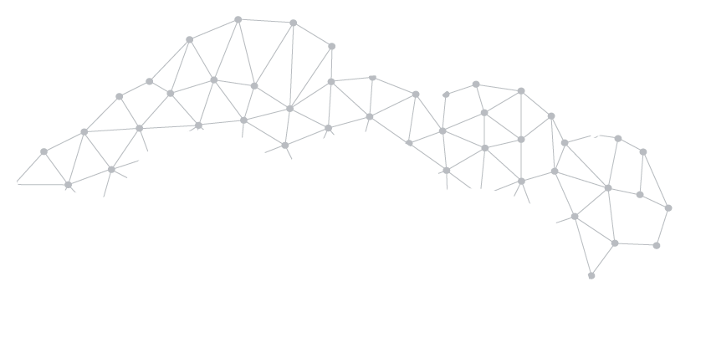
Bad Things Come in Threes Combining Multiple CVE’s Accelerates Actions on Objectives
CVE-2021-34473
CVE-2021-34523
CVE-2021-31207
Critical Severity Microsoft Exchange Remote Code Execution Vulnerability April 2021
Critical Severity Microsoft Exchange Server Elevation of Privilege Vulnerability April 2021
High Severity Microsoft Exchange Server Security Feature Bypass Vulnerability May 2021
Notes:
BAD THINGS COME IN THREES
Exploit chaining enables adversaries to reach AOO faster, allowing them to outmaneuver defenders focused on the reactive mitigation of individual vulnerabilities
This approach does little to disrupt a determined adversary that will simply pivot if one exploit attempt is unsuccessful
We saw this with ProxyShell exploit chain, in which 3 discreet vulnerabilities were ‘chained’ together to provide the TA with RCE capabilities, ability to escalate privilege, and to bypass authentication mechanisms on vulnerable systems
Building on the individual vulnerabilities, the chaining of the 3 exploits also allows for ACL bypass
While these vulnerabilities were first released in the first half of 2021, OverWatch has continued to observe multiple instances of in the wild exploitation as we have moved further into 2022 (ie CSATA-5867) and 5878 indicating that even 6 months + on, adversaries are still having success in identifying entities with exchange assets that remain unpatched and vulnerable
This particular exploit chain was observed by OverWatch being leveraged in intrusions against entities in a range of industries, including Government, Manufacturing and healthcare
Speaking of the importance of focusing on the post exploitation behaviour rather than the individual CVE’s, this post exploitation typically involved the deployment of numerous web shells, use of scheduled tasks for persistence, attempts to disable security tools including Windows defender, harvesting of credentials and even the enumeration of MS exchange email address information.
Many of these TTP’s were also common to nearly all the ProxyShell related intrusion OverWatch has uncovered.
This isn’t going to be the last time this happens – In fact, only last week 2 more exchange CVE’s were disclosed, dubbed ProxyNotShell, and impacting fully patched versions of exchange, and attributed to China-nexus operators
Novel exploit chain: CVE-2022-41040 and CVE-2022-41082 enabling RCE
Once again, this most recent activity reinforces why you need to focus on the post exploitation behaviors, rather than the ability to mitigate individual vulnerabilities

Slide 28
Outpacing The 0-Day With Proactive Hunting
OverWatch Notification
Webshell deployment
Interactive reconnaissance
Attempted credential harvesting
CVE-2022-26134 Disclosure
Retrieval of remotely hosted tooling
Day -5
Day 0
28May2022 UTC
2Jun2022 UTC
22-GC-050 Fal.Con Breakout Session PPT | 2022 CrowdStrike, Inc. All rights reserved.
Notes:
Continuing the theme of why it is so important to focus on behaviours rather than individual CVE’s
Back in June, new confluence vulnerability was disclosed that allowed unauthenticated RCE
POC code quickly emerged alongside public reporting calling out active exploitation attempts from eCrime and targeted adversaries
Almost a week prior to the public disclosure, OverWatch was already observing and notifying our customers of malicious behaviors consistent with a probable web service compromise
Focusing our proactive human hunting efforts on post-exploitation behaviors rather than waiting for and reactively chasing CVE’s in this case enabled critical early warning to customers, subsequently enabling them to contain and response to the activity before the vulnerability was publicly known
A LOT OF THE POST EXPLOITATION IS LIVING OF THE LAND – FEED INTO THE MALWARE-FREE/IDENTITY ABUSE ELEMENT

Slide 29
Regional Focus EMEA
Notes:
Lets take a moment to narrow the aperture and review what’s been happening within the EMEA region…

Slide 30
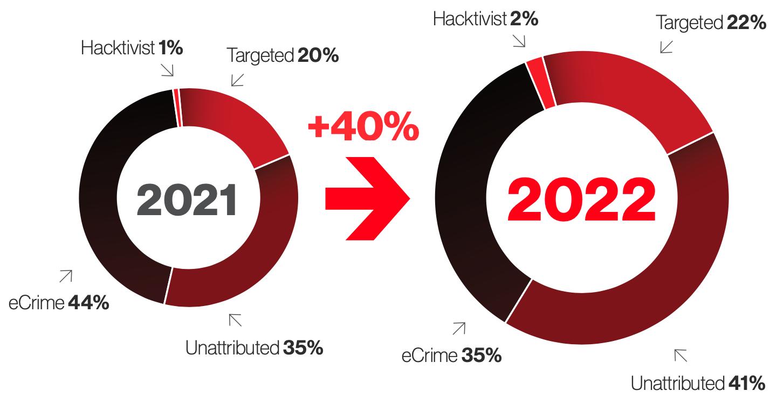
EMEA Intrusion Campaigns By Threat Type
Notes:
Now, EMEA intrusions ARE infact relatively balanced in terms of the volume of eCrime and targeted attacks that we find.
But eCrime adversaries do continue to outpace the targeted adversaries and in the last year they’ve been responsible for 35% of the interactive intrusions we’ve found, and they represent the biggest threat type for organizations.
Broadly speaking, interactive intrusion activity within EMEA was up 40% in the last year, compared with the previous corresponding period. A significant amount of this was driven by eCrime…
But WHAT is continuing to drive the higher proportion of eCrime attacks?
Well to start with, the barrier to entry is much lower now. Even the smaller and less sophisticated eCrime groups can perform big game hunting by leveraging ransomware-as-a-service models and the affiliate networks are growing in popularity.
We also have access brokers posing a threat, because they can gain entry and sell access on, essentially providing the keys to the kingdom and alleviating the need for groups to find an entry point.
And something we continue to see is eCrime adversaries growing in sophistication - attacks are no longer spray and pray. They are using more state-actor style TTPs, moving quickly, and they aren’t averse to using various operating systems and using a range of defense evasion techniques to live off the land and bypass traditional security controls. `
And that speed element is really crucial – as Nick mentioned, the average breakout time stands at 1 hour and 24 minutes, and I cant tell you the number of times I’ve seen adversaries attack during non-business hours. They’re very smart and will attack when defenses are perceived to be at their lowest.
The increase in sophistication is also a reason behind the unattributed figures we can see here – this represents activity where we don’t currently have attribution for, and that’s partly due to a blurring of the lines for activity we see both state groups AND eCrime groups using – its blending together - eCrime adversaries are continuing to step up their game and this makes it more challenging for defenders from an attribution perspective.
We also have the targeted attacks here too and this is definitely being spurred on by developments in the geopolitical landscape. And those adversaries I’ll show you all in just a moment.

Slide 31
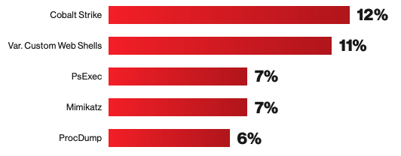
EMEA Industry Sectors In The Cross Hairs
Top 5
Adversary Tools
Notes:
Sectors
For organizations operating within EMEA, the top 5 verticals by intrusion frequency were telecoms, technology, financial, government, and healthcare.
Comparing these to the previous reporting period, the top 3 remain the same, and are perfect targets for data espionage and targeted ransomware attacks. Government has taken the place of professional services in 4th place, that’s a key target for state actors such as the Chinese, north Korean, and Iranian-state groups. And then we also have Healthcare who have taken the place of manufacturing in 5th.
We highlighted the healthcare sector in our report and detailed some AlphV and Phobos affiliate intrusions. It’s a sector that’s seen one of the largest increases in interactive intrusion activity and we have seen intrusions double year over year for healthcare.
Tooling
In terms of the tolling we’ve been seeing across EMEA… some of these remain the same as last year because they represent reliable tools that adversaries, especially eCrime, will leverage in the early stages of an attack during pre-ransomware phase… this would be when they’ve established an initial beachhead (whether that’s though a public facing vulnerability or password spraying for example) then they use tools like ProcDump, PsExec, Mimikatz, network scanners, to fingerprint running services, installed software, and locate any additional systems, users or backups - as you can imagine, they want to set the stage and ensure there is persistent access, and that in some way they can make changes to inhibit system recovery. Sometimes during this stage we also see attempts to remove backups such as VS shadow copies, just to inhibit system recovery.
Cobalt Strike is the most popular offensive tool we see across EMEA, and then in close second is a variety of web shells which were observed in 11% of intrusions within region – this is both commodity and custom webshells and there is an upwards trend in them being used by adversaries regardless of their motive. Webshells… so hot right now…
In terms of the ransomware families we’ve seen within region, the most common have been ALPHV, Dharma, Phobos, Revil, and Hive. Just to name a few.
ALPHV
Dharma
Phobos
REvil
VegaLocker
BlackMatter
Deus
Babuk
Hive

Slide 32
Adversaries Operating In EMEA
PROPHET SPIDER and VICE SPIDER the most prolific eCrime adversaries in region.
STATIC KITTEN, NEMESIS KITTEN and COSMIC WOLF identified conducting targeted intrusion operations against entities in EMEA
Hands-on intrusion activity attributed to 18 distinct named adversary groups
71%
Malware-free
Notes:
Here we can see examples of a few of the most common adversaries found within EMEA intrusions during the reporting period. The most prominent eCrime adversaries have been PROPHET SPIDER and VICE SPIDER. PROPHET – a very opportunistic group, not focussed on any one sector, everyone is in the crosshairs for them – even small family run businesses. And VICE Spider - who are known for using Hive ransomware-as-a-service and performing data extortion… and that’s another thing which has become widely used alongside traditional ransomware tradecraft. Because Ecrime groups know this is just another way to improve their chances of financial gain by threatening to leak or sell sell sensitive data…something known as double extortion…
And then we also have groups like CARBON SPIDER, LABYRINTH CHOLLIMA, STATIC KITTEN… and these other groups have been seen relatively consistently across the other regions aswell.

Slide 33
Looking Deeper: Falcon OverWatch Case Study Ecrime Affiliate Harnesses BlackMatter Ransomware-as-a-Service Tooling to Conduct Big Game Hunting Operations
OverWatch identified an unknown eCrime adversary leveraging CARBON SPIDER’s BlackMatter Ransomware-as-a-Service (RaaS) platform to perform Big Game Hunting (BGH) against a telecommunications organization. The interactive activity involved the use of various commodity tools and this case study details the use of techniques inline with pre-ransomware objectives which were observed across a range of MITRE tactics.
Persistence
Lateral Movement
Collection
Credential Access
Command and Control
OverWatch identified malicious interactive activity indicative of an eCrime adversary. The threat actor conducted activity inline with persistence objectives including the creation of a new domain account and scheduled tasks to routinely execute a tunnelling tool named Go Simple Tunnel.
The adversary pivoted from a host without Falcon sensor coverage and operated over RDP services via an administrator account. They moved laterally between multiple hosts, deploying a range of common eCrime tooling.
The adversary continued by enumerating local files and directories and leveraged a legitimate version of WinRar to archive the contents of various network shares.
The adversary leveraged Procdump and Mimikatz in an attempt to harvest credentials and extend their foothold within the environment.
Finally, the adversary attempted to transfer files using the MEGASync transfer tool before executing the BlackMatter ransomware binary, which in turn beaconed outbound to known BlackMatter C2 infrastructure.
Notes:
So now I’ll take you through 3 examples of intrusions we found during the past year within EMEA.
This first intrusion is associated with an eCrime affiliate who leveraged CARBON SPIDER’s BlackMatter ransomware-as-a-service platform.
This intrusion was against a telecoms organization and we initially found activity which was taking place under a domain admin account with activity originating from a host without EDR coverage.
We caught them looking for ways to survive a reboot and establish persistence, and so we found a new domain account being created, along with scheduled tasks which would execute a tunnelling tool every hour. This tool was Go Simple Tunnel and the scheduled task would initiate a reverse shell to remote infrastructure and act as a backdoor if they needed a re-entry point. The scheduled task name was also masquerading as a legitimate Windows service.
They were actually using RDP to move laterally under an administrator account, which is how they managed to extend their reach to 7 additional hosts. And so at the moment some of this activity “could” already be deemed as legitimate because things like scheduled tasks, and RDP traffic happens in most environments and activity taking place under the administrator account could be benign… but we also found a burst of recon activity coinciding with this, in addition to several tools being copied to them.
These tools included WinRar, Mimikatz, MEGAsync, and BlackMatter.
At this point threat hunters had already notified the customer to prompt incident response. And we were starting to see indications that they are intending to steal credentials, exfiltrate data, and execute ransomware. This is popular affiliate tradecraft and so its always important to catch this in the early stages so that you can contain the hosts.
After this we started to see some local file enumeration and network share discovery, and when they were a bit more familiar with the environment they archived the contents of a few network shares using the WinRar tool they had downloaded.
Next on their list was to harvest credentials and so they used Mimikatz and ProcDump to extract the content of LSASS into a dump file.
By this stage further notifications were provided as the activity continued to evolve, and the adversary then used MEGASync in an attempt to exfiltrate the files they had compressed, before using Rundll32 to proxy the execution of their ransomware binary and establish C2 beaconing.
So this intrusion definitely spoke to the importance of visibility – hunters can’t find what they can’t see, and as soon as the adversary pivoted to a host with sensor coverage we were able to see their tradecraft. A few things stood out to us, so the use of common eCrime tooling and burst of host reconnaissance and discovery. But they also used various defense evasion techniques such as system binary proxy execution and service name masquerading – defense evasion is the most used MITRE tactic that we find used – and threat hunting is a perfect for finding this type of tradecraft which attempts to blend in with everyday telemetry. RDP is also an avenue they exploited so its definitely worth considering auditing remote access tooling and also correlating this activity to see if if happens outside of expected hours or from a single account to many hosts in a short timeframe.

Slide 34
Looking Deeper: Falcon OverWatch Case Study Threat Hunters Catch STATIC KITTEN Extending Their Network Foothold and Configuring Multiple Web Shell Binaries
OverWatch observed the state-nexus adversary STATIC KITTEN attempting to move laterally between multiple Windows hosts before configuring web shell tooling. The adversary displayed efforts to manually debug their tooling and attempts were made to authenticate an RDP session using a pass-the-hash attack.
Initial Access
Execution
Defence Evasion
Lateral Movement
Persistence
Adversary operates under a compromised domain user account from a host without Falcon sensor coverage.
Wmiexec used to establish an interactive shell on a secondary host and to perform host reconnaissance.
The adversary leverages PowerShell to modify the Windows registry and enable RestrictedAdmin mode.
The adversary performs a pass-the-hash attack to establish an RDP session with an internal host.
Attempts are made to interact with local web shell files and the adversary acquires a Jwrapper-Remote Access binary in a likely attempt to diagnose runtime issues with their web shells.
Notes:
This next intrusion featured STATIC KITTEN, an Iranian-state adversary who OverWatch found operating under the context of a compromised user account, but the initial access is currently unknown because they initially operated on a host without Falcon sensor coverage. We caught them using what looked to be a bespoke webshell and they used wmiexec to establish a command shell on a second host. Around the same time we also saw them carry out some basic host recon and downloaded two proxy tools, Venom proxy and Ligolo… and also a few low prevalence webshell files.
At this point OverWatch had contacted the customer and the adversary continued by carrying out some defense evasion – using PowerShell to interact with the registry and enable RestrictedAdmin mode – this is a security feature that was designed to prevent a user’s passwords being transferred and stored in cleartext within memory. So if an adversary were to use mimikatz on the terminal server then it wouldn’t prove very useful. But the adversary knew this and the reason they enabled it was to actually allow for a pass-the-hash attack as a means to authenticate an RDP session.
And that’s exactly how they managed to move laterally, by passing the username and password hash of the account they had already compromised, and gaining access to an additional host.
After this we saw them inspecting their web shell files and attempting to execute them, only to see it being blocked by the Falcon sensor. They also, out of frustration, downloaded a Jwrapper-Remote Access binary that they were using to diagnose runtime issues with their web shells.
This intrusion again touches on the need to eliminate blind spots from networks and how continuous hunting is a key defence for finding malicious hands-on. Experienced hunters can look at the context behind a chain of events like wmi activity, PowerShell and registry activity and RDP connections and filter it from the noise… because lets be honest, this stuff happens all the time. Its important threat hunting teams proactively go looking for activity like this… just take registry modifications… that’s an area where theres a huge amount of things you can investigate… anything from Wdigest changes, to ASEP changes. And infact in our report we also reference a table of registry changes that an adversary used to disable defensive controls and tamper with security configurations, so we definitely recommend checking that out.

Slide 35
Looking Deeper: Falcon OverWatch Case Study Unknown Adversary Exploits Confluence Server and Performs Extensive Reconnaissance and Webshell Installation.
An unknown adversary was observed gaining a network foothold following the exploitation of a Confluence vulnerability. The adversary conducted a range of discovery actions on the Linux host before configuring web shell binaries and preparing for data exfiltration.
Initial Access
Discovery
Collection
Defence Evasion
Persistence
Adversary exploits a public facing Confluence application to gain interactive access with a Linux server.
Native tooling was used to perform extensive host reconnaissance and enumerate local files and directories.
The adversary locally stored the results of their discovery activity within encrypted volumes before staging them for exfiltration.
Adversary makes efforts to rename files and obfuscate commands before decoding a web shell binary within a local directory.
Finally, the web shell files are used by the adversary to maintain persistence and to allow for continued actions-on-objectives.
Notes:
This is the last one I wanted to touch on for todays session, and its an “as yet” unattributed adversary who we found operating on a Linux server following a Confluence server exploit…an exploit of a CVE that was only published two days before this compromise…
And once they gained access they tested outbound connectivity and used native tooling to live off the land and carry out host and network reconnaissance and inspect local files. This discovery activity was representative of malicious hands-on and so our hunters provided a notification and then continued to triage…
And the next thing we saw was indicative of data theft objectives... We saw them using the opensll command to encrypt the contents of various files and stage them in a local directory.
After this they were also seen downloading a custom webshell, renaming it and then decoding it ready for use…. And the purpose for this was to allow for a method of persistent access and to extend their capabilities on the host.
Fortunately, shortly after this the customer remediated following our escalation.
This one is an example of why its important to consider mac and linux hosts during hunting operations. Be aware of the systems in your environment and it can be helpful to also arm yourself with a network diagram for those hunting in-house. But as always, if threat hunting isn’t something you can support in-house its definitely recommended to partner with a team who can, and its ultimately something that needs to happen 24/7 to uncover adversaries like this and prevent significant damage.
Okay, and with that, I’ll pass you back to Nick who will be telling you what we can expect as we look forward to 2023…

Slide 36
Looking Ahead
What we can expect in 2023

Slide 37
What To Expect in 2023
Adversaries continue to adapt and pivot to the cloud
Identities will remain under siege
Ransomware continues its evolution with hybrid cloud components
Living-off-the-API
Rise in post exploitation frameworks such as IceApple
Adversaries will continue to pursue the path of least resistance, deferring to what works
Exploit chaining to add renewed focus on security hygiene as legacy vulnerabilities continue to remain unpatched
Notes:
Next year will see a big focus on identity as adversaries continue their assault on access credentials and abuse valid accounts for initial access and lateral movement
When we think about the adversary and the way they operate - Evolution doesn’t necessarily mean something new, may be pivoting back to something that just works (Example, use of ISO’s to deliver malicious software by the likes of WIZARD SPIDER and COZY BEAR (BazarLoader, Cobalt Strike etc)
Adversaries will continue to aggressively go after the low hanging fruit – This is particularly true with eCrime where the barrier to entry is getting lower

Slide 38
Keys To Outpacing The Adversary
Always-on Proactive Hunting
Patented Technology
SEARCH
Methodology
Hunting findings continuously hone platform detection and prevention capabilities
Deployment of new behavioral-based patterns directly prevent millions of malicious events
Enables discovery of novel adversary behavior with greater speed and scale
Cardinality based capabilities allow burst identification of potentially malicious activity
Ancestry assessment using AI to predict event maliciousness
Event clustering and violation detection
Proprietary hunting methodology
Highly structured, iterative hunting workflows
Notes:
The keys to success when it comes to hunting and disrupting increasingly capable and sophisticated adversaries as we look ahead
3 key elements that build on our foundation of world-class human talent and unparalleled visibility and enable us to stay a step ahead of the adversary
Always on proactive hunting
Patents
5 patents granted in the last 12 months alone
These patents build on our existing custom and bespoke tooling and include Cardinality based technology allowing for the identification of related and coinciding bursts of potentially malicious activity along with ability to assess ancestry, using AI to predict the maliciousness of an event based on command line ancestry
Leveraging Search
To enable forward looking methodology
What allows us to step confidently into the unknown
Backed by patented capabilities, continuous hunting leveraging human ingenuity to hunt unknowns and hone falcons capability to protect against growing list of knowns
SEARCH: Formalized but flexible

Slide 39
The Future of Hunting
Threats move to the cloud
Adversaries pivoting from traditional assets to the cloud
Extend visibility across cloud containers, workloads, clusters and other infrastructure
Uncover and disrupt attempts to exploit cloud assets
Cloud oriented IOA’s and IOM’s for the control plane
71%
Malware-free
Notes:
CLOUD
Cloud oriented IOA’s and Indicators of misconfiguration for the control plane
Adversaries increasingly seeking to navigate and exploit cloud workloads
Adversaries increasingly proficient operating and pursuing their objectives in hybrid environments
Allow for discovery of novel and sophisticated malicious behaviors, control plane and serverless vulnerabilities and misconfigurations, container escapes
Enumeration of cloud related configuration files
Use of in-built cloud administration utilities to enumerate credential stores

Slide 40
1
Deploy comprehensive cloud-native technology to provide critical visibility and prevention
2
Augment technology with human-led Threat Hunting
5 Steps To Beat The Adversary
3
Secure the identity
4
Look beyond the CVE
5
Know your adversary
Notes:
You can’t stop what you can’t see, and now more than ever its imperative for organizations to deploy a combination of technology based controls and human led hunting services to ensure they are best positioned to defend against the attacks of tomorrow. While technology provides the critical prevention capabilities for the known bads, augmenting this technology with human eyes on glass is a must have to enable the identification and disruption of the last 1% of malicious activity that seeks to subvert automated controls
Augment technology with human driven hunting – Its not all about malware any more!
Secure the identity
Look beyond the CVE
Know your adversary! In this report alone we showed that we had attributed interactive intrusion activities to 36 different adversaries, all with different motivations – organize your defenses for this

Slide 41
Know The Tradecraft. Know The Adversary. Hunt Relentlessly.

Slide 42
Q&A

