Slide 4
2023 Global Threat Report
See what they see,
know what they know
Issam Aouad Tabet
Sales Engineer

Slide 5
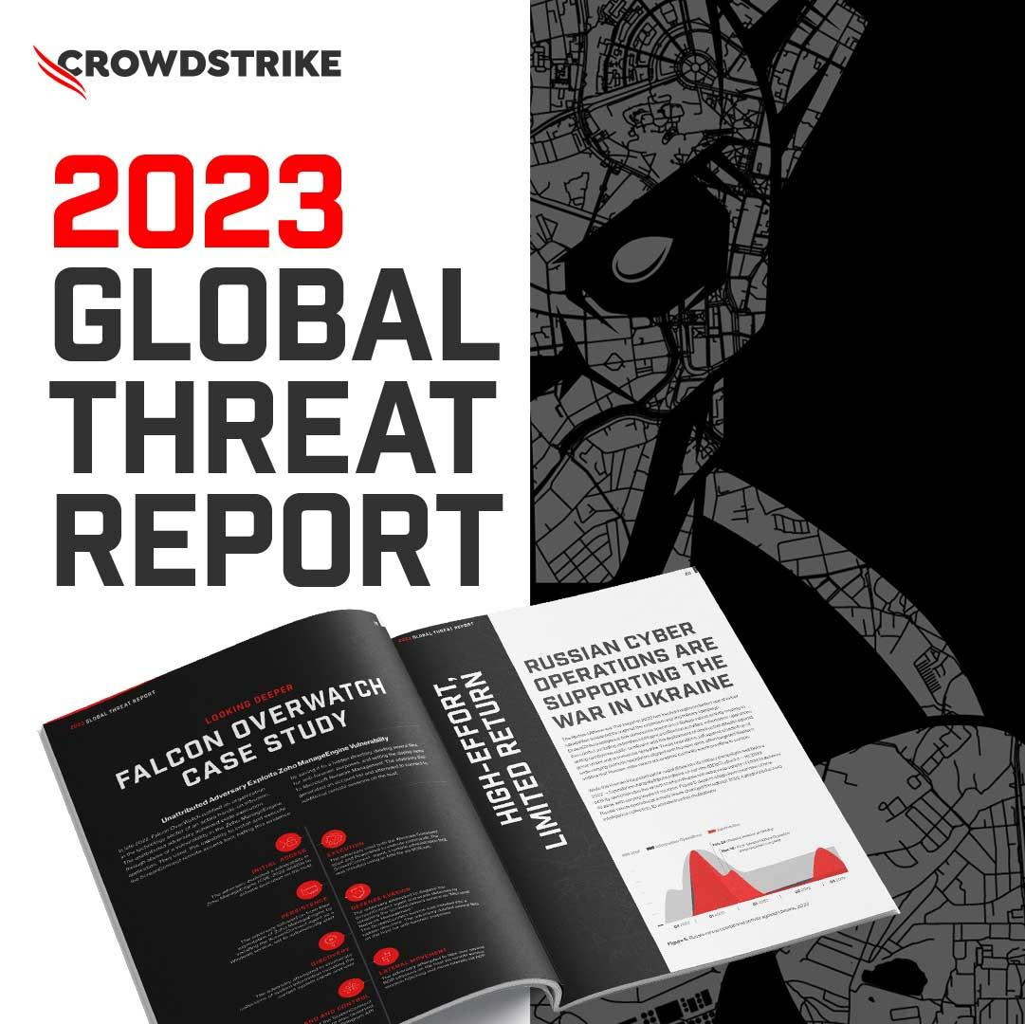
Agenda
Threat landscape
2022 themes
5 steps to be prepared
2023 CrowdStrike, Inc. All rights reserved.

Slide 6
Threat Landscape
Breakout time – Every second counts
Access broker boom
Adversaries move beyond malware
Interactive intrusions
2023 CrowdStrike, Inc. All rights reserved.

Slide 7
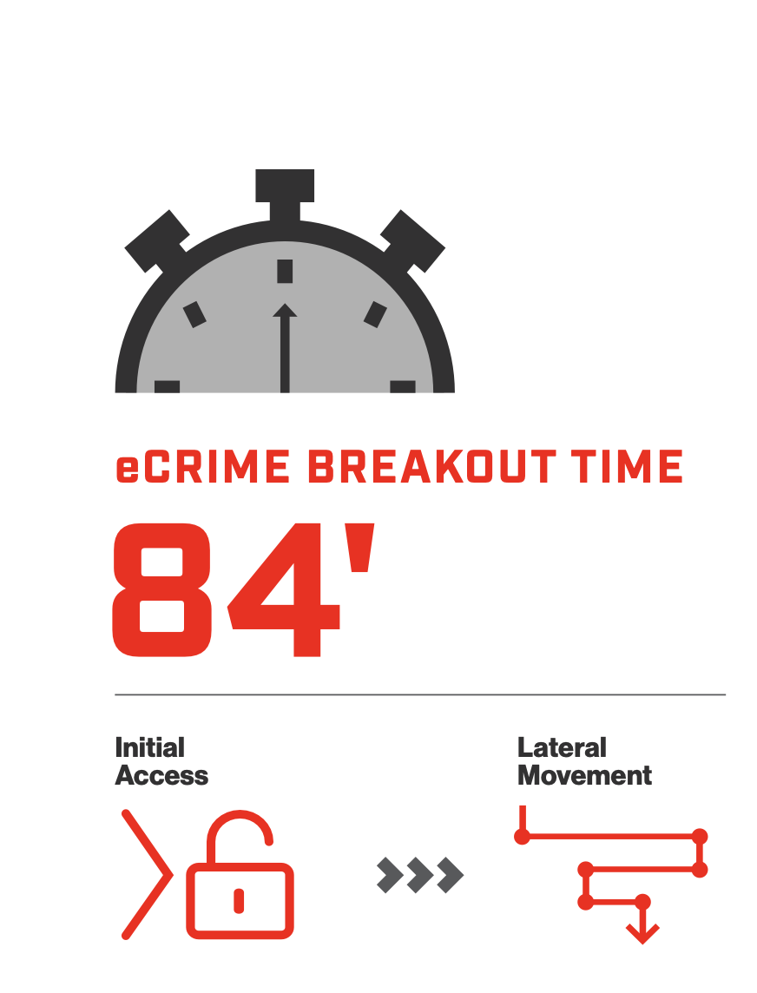
Every Second Counts
Minimize cost and damage
To contain the threat, protectors must respond within the breakout time
Adversaries are getting faster
Breakout time declined from 98 minutes in 2021 to 84 minutes in 2022
Beat the 1-10-60 rule
Detect in one minute, investigate in 10 and respond in 60
2023 CrowdStrike, Inc. All rights reserved.

Slide 8
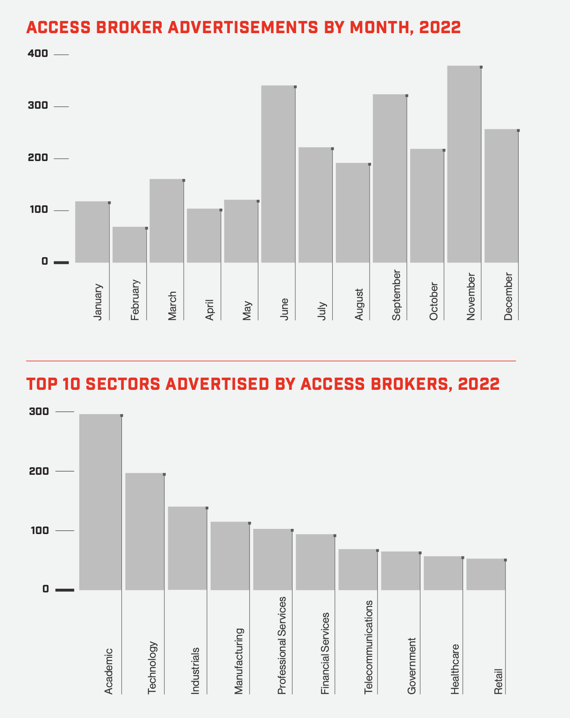
Access Broker Boom
Acceleration of demand
Popularity of services increasing with more than 2,500 advertisements – a 112% increase from 2021
Buy a la carte or in bulk
Several brokers will sell in bulk as others will use a “one-access, one-auction” technique.
Access methods remain consistent
Abuse of compromised credentials obtained by information stealers or purchased in log shops on the dark web
80% of all breaches use compromised identities and 50% of organizations have experienced an Active Directory (AD) attack in the last two years.
2023 CrowdStrike, Inc. All rights reserved.

Slide 9
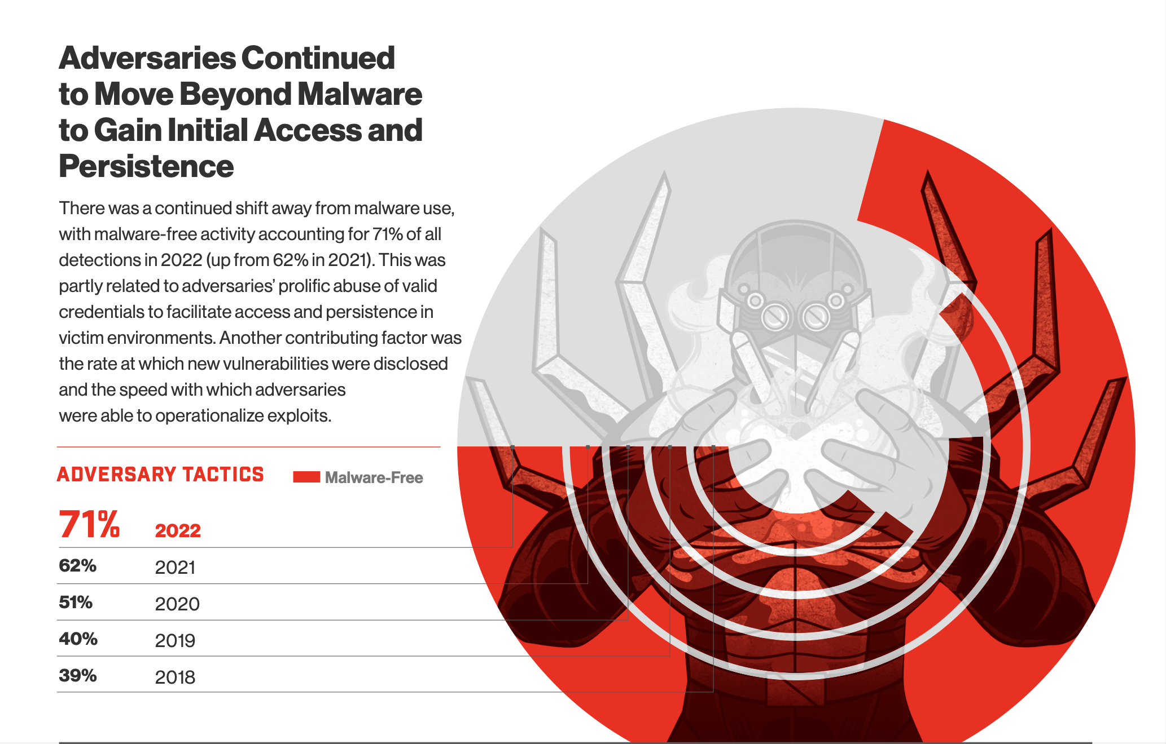
2023 CrowdStrike, Inc. All rights reserved.

Slide 11
2022 Themes
eCrime actors gained notoriety for high-profile attacks
The continued rise of cloud exploitation
Discovery, rediscovery and circumvention: The 2022 vulnerability intelligence landscape
High-effort, limited return: Russian cyber operations are supporting the War in Ukraine
Dominating the espionage landscape: China-nexus adversaries significantly increased 2022 operational scale
2023 CrowdStrike, Inc. All rights reserved.

Slide 12
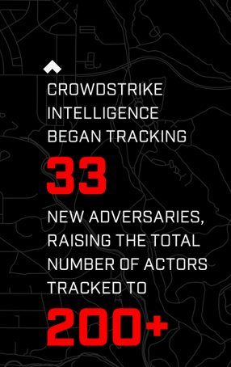
eCrime Actors Gained Notoriety for High-Profile attacks
Rise in ”double-extortion” model
20% increase in the number of adversaries conducting data theft and extortion without deploying ransomware
SLIPPY SPIDER
Targeted technology giants with data theft and extortion
SCATTERED SPIDER
Used social engineering to overcome multi-factor authentication
2023 CrowdStrike, Inc. All rights reserved.

Slide 13
The Continued Rise Of Cloud Exploitation
Increasing exploitation
Observed cloud exploitation cases grew by 95%; cases involving cloud-conscious actors nearly tripled from 2021
“CrowdStrike Intelligence saw actors shift away from
the deactivation of antivirus
and firewall technologies,
as well as from log-tampering efforts. Instead, they were observed seeking ways to modify authentication processes and attack identities.”
Cloud-conscious TTPs
Expanding TTP repertoire includes cloud account discovery, public facing apps for initial access, use of higher-privileged accounts for escalation
Suspected PANDA becoming cloud-conscious
Adversaries growing more confident leveraging traditional endpoints to pivot to cloud – and vice-versa
Stopping cloud breaches requires the combination of agentless capabilities that protect against misconfigurations and control plane attacks with agent-based runtime security that protects cloud workloads.
2023 CrowdStrike, Inc. All rights reserved.

Slide 14
The 2022 Vulnerability Intelligence Landscape
Vulnerability discovery and rediscovery
Adversaries modify – or even reapply – the same exploit to target similarly vulnerable products.
Circumvention of earlier patches
Zero-day and N-day vulnerabilities observed in 2022 demonstrated adversaries’ ability to leverage specialized knowledge to circumvent mitigations from previous patches to target the same vulnerable components
Microsoft’s crisis of trust
MSFT has issued more than 1200 patches in 2022, including 28 zero days
Patch management is not set and forget - adversary sophistication requires prioritization of critical patches and defense in depth that can immediately identify adversary activity.
2023 CrowdStrike, Inc. All rights reserved.

Slide 15
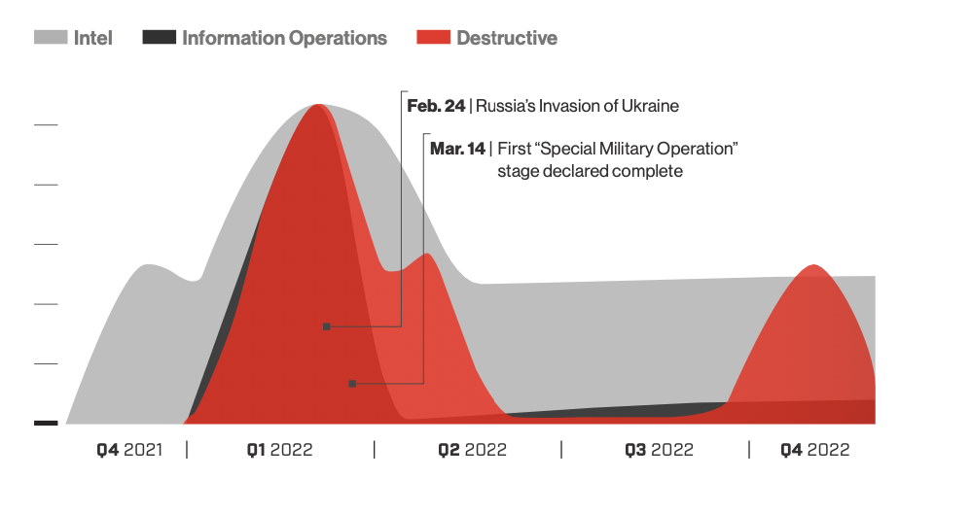
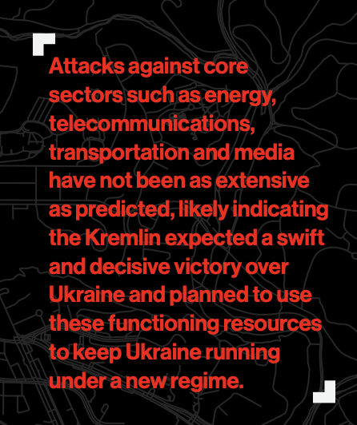
High Effort, Limited Return Russian Cyber Operations
Supporting The War In Ukraine
Stopping breaches requires an understanding of the adversary, including their motivations, techniques and how they’re going to target your organization.
2023 CrowdStrike, Inc. All rights reserved.

Slide 16
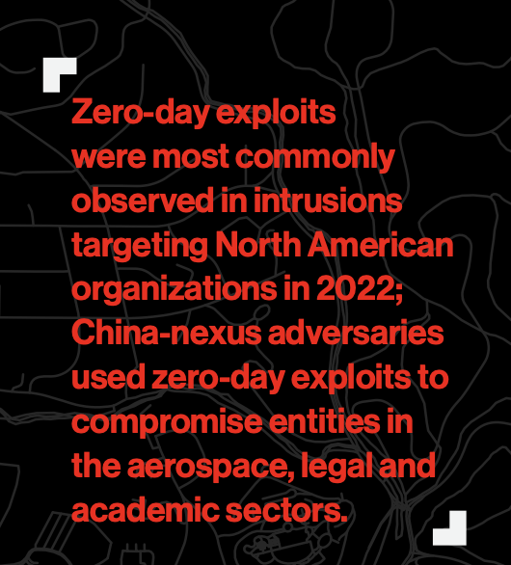
China-nexus adversaries significantly increased 2022 operational scale
Exploits to gain initial access
China-Nexus Adversaries continued shifting toward exploitation of web-facing services
Increase in use of zero-day exploits
Enterprise software continued to be a high-priority target. Additional zero-day exploits include weaponized MSFT Office documents.
Target Taiwan
Adversaries growing more confident leveraging traditional endpoints to pivot to cloud – and vice-versa
China-nexus adversaries were observed targeting nearly all 39 global industry sectors and 20 geographic regions CrowdStrike Intelligence tracks.
2023 CrowdStrike, Inc. All rights reserved.

Slide 17
1
Gain visibility into your security gaps
Stop The Bleed:
5 Steps To Be Prepared
2
Prioritize identity protection
3
Prioritize cloud protection
4
Know your adversary
5
Practice makes perfect
2023 CrowdStrike, Inc. All rights reserved.

Slide 18
With Outcomes Powered by the Unified CrowdStrike Falcon Platform
Endpoint Security & XDR
Cloud Security
Threat Intelligence
Identity Protection
Security & IT ops
Observability
Managed Threat Hunting
Managed Detection & Response
Incident Response
Proactive Services
Automation & Orchestration
Data Fabric
Threat Graph
Asset Graph
Intel Graph
APIs & Ecosystem
Unified Agent | Agentless
Notes:
CrowdStrike relentlessly focused on empowering customers by releasing new services and features throughout 2022. CrowdStrike Falcon® Intelligence Recon — a tool that enables customers to uncover potentially malicious criminal underground activity — gained new features including underground trends reporting, typosquatting detection, complex historical search functionality and Falcon Intelligence Recon support for managed security service providers (MSSPs).
The year 2022 also saw the launch of CrowdStrike Falcon® Surface, an external attack-surface management product resulting from CrowdStrike’s acquisition of Reposify.
Also in 2022, CrowdStrike created a Vulnerability Intelligence module to help customers quickly identify information associated with vulnerabilities and provide relevant intelligence reporting to support their understanding of vulnerability context. For further customer-driven research and analysis, CrowdStrike released the MITRE ATT&CK® Navigator1 for tracked adversaries, which provides customers with particular actors’ MITRE ATT&CK techniques and sub-techniques as well as links to associated MITRE information and relevant CrowdStrike Intelligence reporting.
CrowdStrike Data Fabric and Falcon Long Term Repository
Humio’s technology will power the CrowdStrike Data Fabric.
This provides a central repository of all telemetry across our platform, which underpins our Security Cloud and graph technology.
The data fabric integrates data from multiple sources to deliver a single, powerful dataset to expand our Security Cloud and power all of our modules.
Unlike a data lake, the data fabric pulls distributed data from across the organization, and enriches it to power our modules and services.
This makes sure you have the right data at the right time.
It double-downs on our strategy of ‘collect once, re-use everywhere.’ It will help power our XDR.
You can store EDR telemetry for up to one year or longer at a much cheaper storage cost.
Your teams can search historical data to uncover the full extent of threats.

Slide 19
Thank you

