Slide 1
From One-Size-Fits-All to Adaptive Defence: Rethinking Human Centric Cybersecurity
Scott Jenner – Sales Engineer
Notes:
Welcome

Slide 2
People are your primary attack vector.
74%
8%
OF BREACHES
OF USERS
80%
1
CAUSE
INVOLVE THE HUMAN ELEMENT
2
OF SECURITY INCIDENTS

Slide 3
Security is personal?​
Security is Personal?

Slide 4
RESPONSE TEAMS ARE LEFT OVERWORKED

Slide 5
TWO TOOLS IN AN ORGANISATIONS TOOL BELTS
Notes:
- Cisco Steve: Breach, Board members immediate action, Push more training, do more Phishing training and if users engage with malicious content we need to give them a warning or fire.
- Affects Culture and performance of the team.
- Invested a huge part of my budget on detection and response technologies, but my security team is overworked and burnt out. And when we look at the incidents 3 out of 4 are are rooted in Human error and the board wants to implement a three strike and your out rule.
-Breach, Board members immediate action, Push more training, do more Phishing training and if users engage with malicious content
- Affects Culture and performance of the team.
- This is a problem that affects all organisation of all sizes. Human risk is affecting everyone.
- Is there a better way.

Slide 6
Employee Mistakes
Are Inevitable
Incidents Aren't
Notes:
- Trying to constantly improve our users awareness and focusing on this being the only tool in our toolbox, lets focus on what we have control over.
- The way we do this is through Human risk management,

Slide 7
You Can’t Improve
What You Don’t Measure
Notes:
- Limited visibility into Human risk, today we are simply measuring Awareness training Completion and simulated pishing training, nether of this are giving a good look into a risk that they appose from a human element perspective.
- 2003

Slide 8
A 360° View Into A User's Role, Access & Decisions
Individual Risk Insights
Clicks on an email link from a questionable sender
Access to employee data
Overall Risk
7.2
Sends files from their business email to personal email
Visits inappropriate sites
Attacked Factor
High
Actual Phishing
8.1
Simulated Phishing
2.1
Attempts to execute malware
Is frequently attacked
Malware
1.2
Sensitive Data Handling
1.3
Secure Browsing
4.3
Uploads confidential documents to the public cloud
Clicks on ad bait
Notes:
The good news is individuals make security decisions on a daily basis.
Strengths and weaknesses.
Understanding where the risk is actually sitting.

Slide 9
Role, Access & Decisions Combined Into a User Risk Score
Individual Risk Insights
Overall Risk
7.2
Attacked Factor
High
Actual Phishing
8.1
Simulated Phishing
2.1
Malware
1.2
Sensitive Data Handling
1.3
Secure Browsing
4.3
Notes:
We are talking about buying a platfrom that takes all of its own data into a single area.
Lets pull information from the tools we want to use.

Slide 10
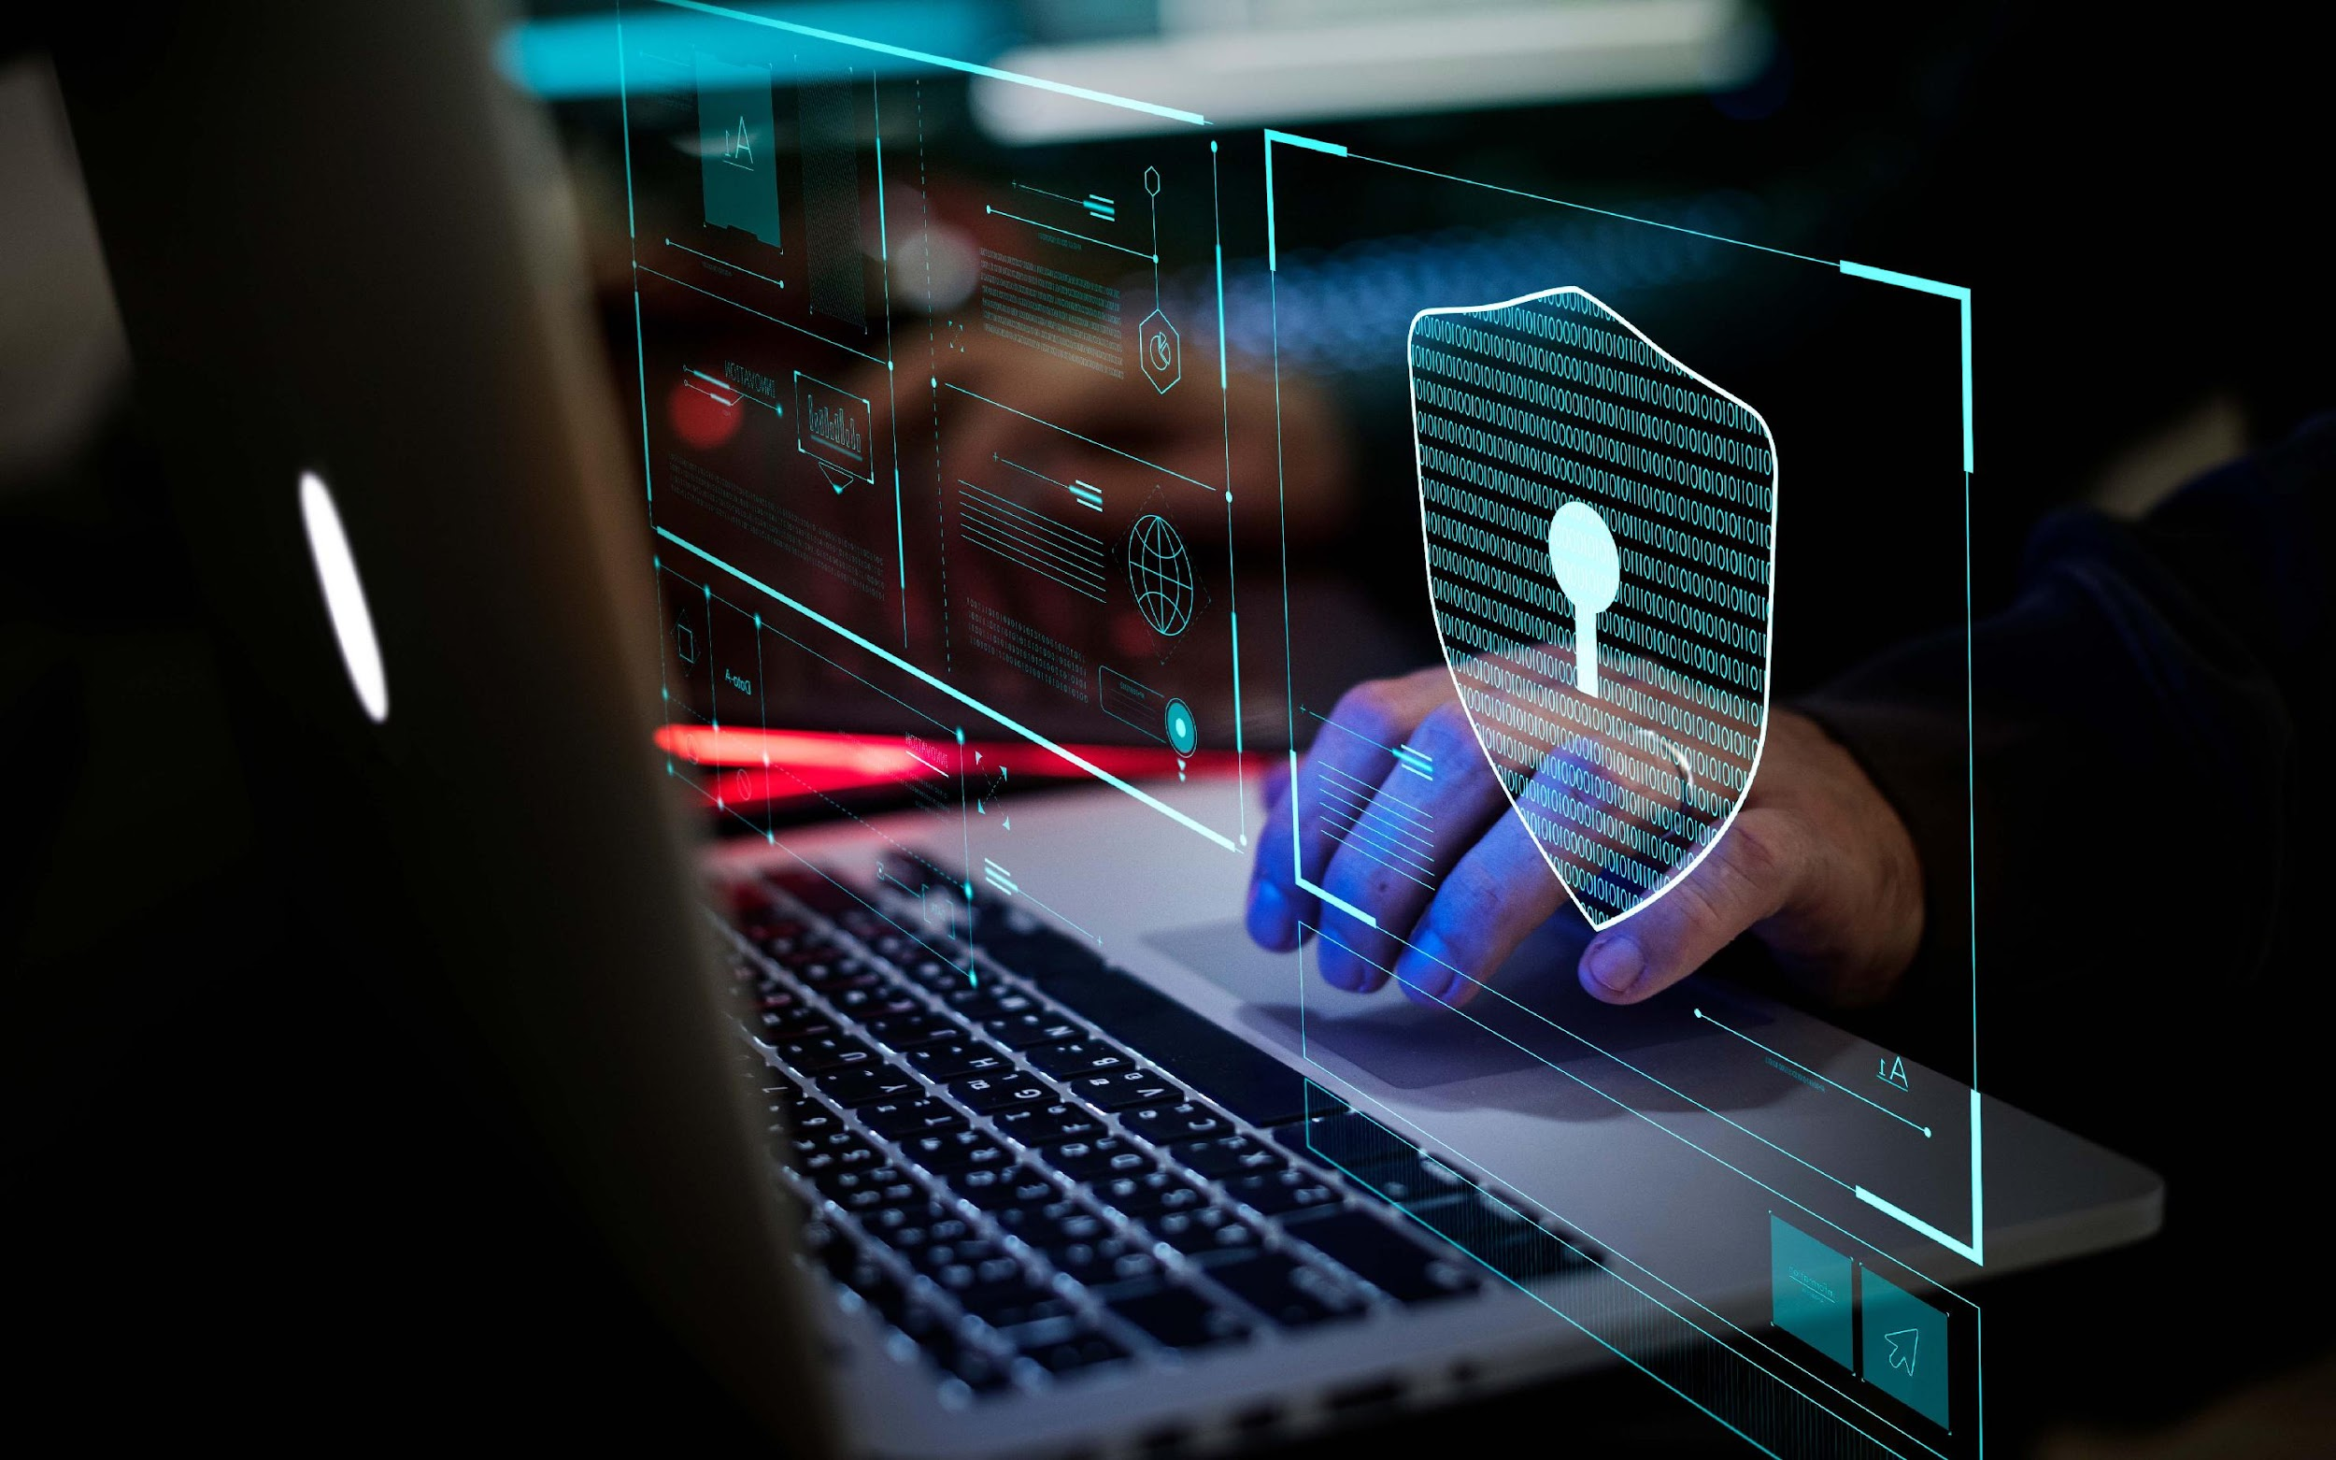
Goodbye One-Size-Fits-All.
Hello Adaptive Protection.

Slide 11
We measure individual risk for adaptive protection
4.7
6.3
9.1
Training opt-out
Recognition for good security performance
Baseline security controls
Tailored feedback on how to improve
Increase email security controls
Low intervention
High intervention
Notes:
Steve – Security nudges, shorten MFA time, increase the sensitive of security scans, activate alerts.
Alicia – Much lower risk, does not need to do 60 min compliance training, she can do the 10 min version, ease security restrictions, allow her to work at the speed of innovation.
Seems like a simply slide and idea but 99% of organisation are not doing this.

Slide 12
Human Risk + Security Interventions
Risk Data Sources
Intervention Workflows
Email Security
Web Security
IAM
SIEM
Endpoint
Device Mgmt
DLP
Awareness Training Adaptive Training Assignment, Scorecards, Feedback/Alerts
Visibility
Risk Dashboard, Security watchlists, Scorecards
Email Security
Adaptive policies & protection
Additional Controls
Conditional Access,
Access Revocation, Entitlement Reviews, Web, Endpoint controls
Security Behaviors
Security Ecosystem Integrations
Identity & Access Mgmt.
Endpoint Web Gateway Threat Intelligence XDR SIEM / SOAR Managed Services
Workflow Automation
Adversary Tactics
Role & Access
4.7
Workforce Data
Attacked Factor
Phishing
Malware

Slide 13
Human Centric Cybersecurity - Summary
Visibility into organizational risk
Tailored training & personalized nudges
Adaptive protection via security tools
Identify and benchmark riskiest groups and behaviors.
Gain visibility into repeat offenders and security champions.
Motivate behavior change with personalized nudges, scorecards, and training.
Provide simple, actionable ways to improve security decisions and measure improvement.
Inform policy decisions of protection layers like email and authentication to provide an appropriate level of control.

